Slide 1
9th Grade Virtual Parent Meeting
Blountstown High School
2021-2022

Slide 2
Dual Enrollment
Students are eligible to take Dual Enrollment classes beginning the summer after 9th grade. Students interested in Dual Enrollment must take the PERT test, which is given at BHS in the Spring Semester. The PERT has 3 sections: Reading, Writing, and Math. To be eligible to dual enroll, students must meet the following scores on PERT: Reading-106
Writing- 103
Math- 123

Slide 3
Volunteer Hours
Many scholarships require students to have volunteer hours during their high school career. Volunteer forms are available in the guidance office. Many opportunities to volunteer are announced at school, on Facebook, and through Parent Square. A copy of the volunteer form may also be found on the school website,www.blountstownhigh.org.

Slide 4
Bright Futures Scholarship Program
Florida Academic Scholarship (FAS)/Florida Medallion Scholarship (FMS)
Submit the Florida Financial Aid Application no later than August 31 after high school graduation
Complete the 16 college-preparatory courses required for admission to a state university
Achieve the required weighted GPA in the 16 college-preparatory courses
Complete the required composite ACT or combined SAT score
16 High School Course Credits: High School Bright Futures Weighted GPA
4 English FAS- 3.50 FMS- 3.00
4 Mathematics (at or above Algebra I level)
3 Natural Science (2 must have substantial laboratory) College Entrance Exams: Volunteer Hours:
3 Social Science FAS: 29 ACT or 1330 SAT 100 hours
2 World Language (sequential in same language) FMS: 25 ACT or 1210 SAT 75 hours

Slide 5
Bright Futures Scholarship Program
Florida Gold Seal Vocational Scholarship (GSV)
Submit the Florida Financial Aid Application (FFAA) no later than August 31 after high school graduation
Achieve the required weighted 3.0 GPA in the non-elective high school courses
Take at least 3 full credits in a single Career and Technical Education program
Achieve the required minimum 3.5 unweighted GPA in the career education courses
Complete 30 service hours
Achieve the required minimum scores on one of the college entrance exams per the chart below
Exam Type: Subtest: Required Score:
ACT Reading 19
English 17
Mathematics 19
SAT Reading 24
Writing and Language 25
Mathematics 24
PERT Reading 106
Writing 103
Mathematics 114

Slide 6
Bright Futures Scholarship Program
Florida Gold Seal CAPE Scholarship (GSC)
Submit the Florida Financial Aid Application (FFAA) no later than August 31 after high school graduation
Earn a minimum of 5 postsecondary credits through CAPE industry certifications that articulate for college credit
Complete at least 30 service hours
Eligible CAPE Certifications: Active Articulation Agreements Summary
www.fldoe.org/core/fileparse.php/7525/urlt/active-articulation-summary.xlsx

Slide 7
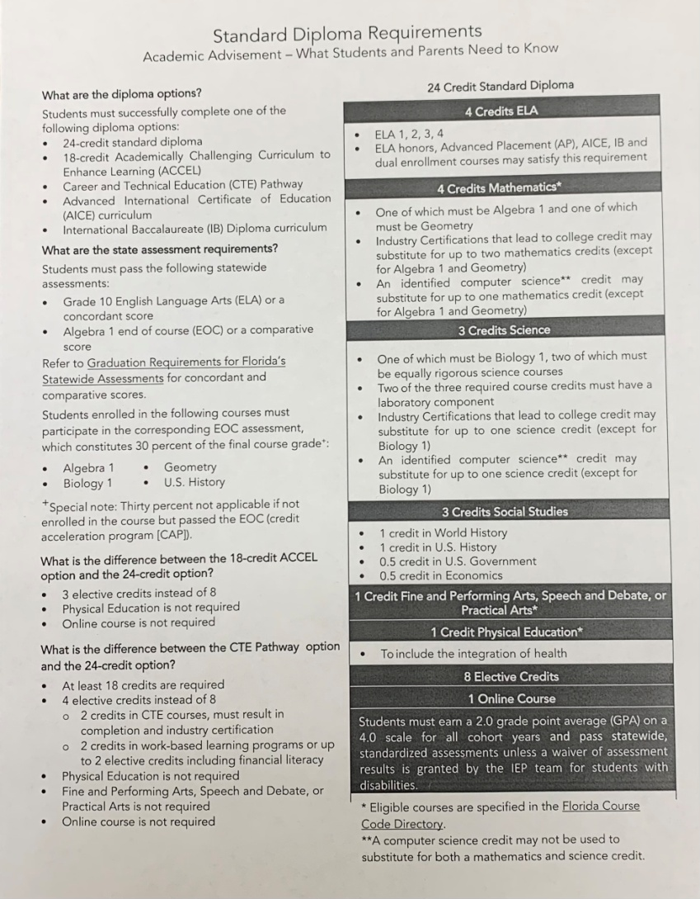
Standard Diploma Requirements

Slide 8
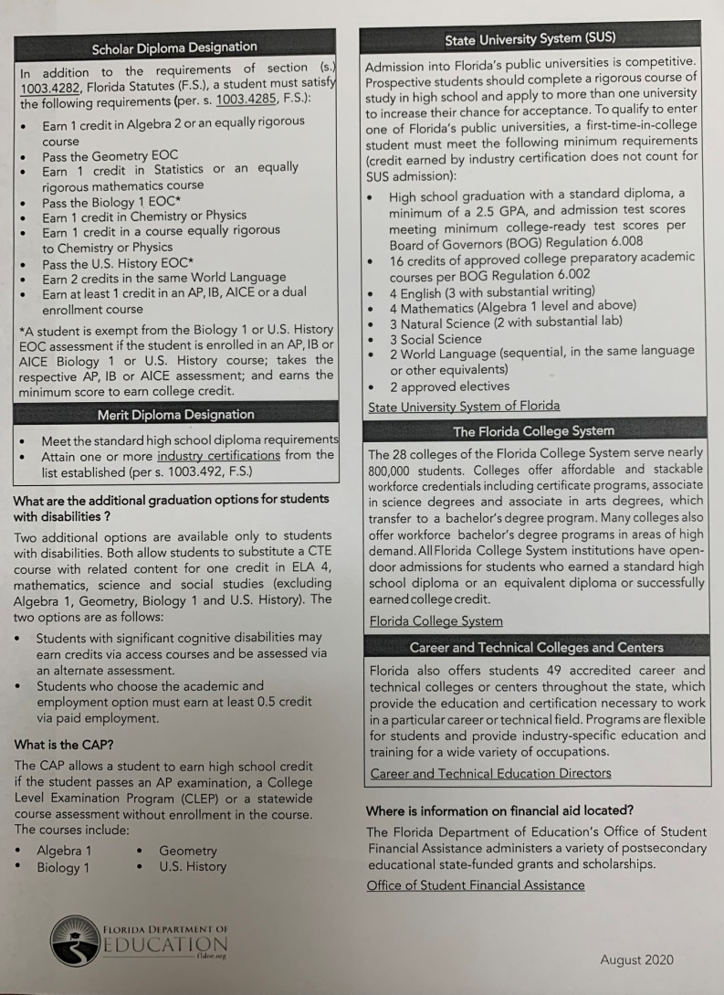
Diploma Designations

Slide 9
Valedictorian/Salutatorian
The graduate with the highest GPA will be the valedictorian and the second highest GPA will be the salutatorian. Courses used to determine the GPA for salutatorian/valedictorian will be the
same courses used for Bright Futures Academic determination, which are as follows:
4 Language Arts Credits which must include 4 of the following:
ELA I, II, III, or IV
Honors ELA I, II, III, or IV
AP ELA I, II, III, or IV
ENC 1101 or ENC 1102
4 Mathematics Credits
Algebra I, Algebra I Honors, or AP Algebra I (required)
Geometry, Geometry Honors, or AP Geometry (required)
2 elective math credits which may include dual enrollment
3 Science Credits
    Biology, Biology Honors, or AP Biology (required)
    2 science credits which may include dual enrollment courses
    2 science credits which must have a laboratory component
    2 science credits must be equally vigorous
3 Social Studies Credits
World History, World History Honors, AP World History , or Dual Enrollment World History
Us History, US History Honors, AP US History, Dual Enrollment US History
½ credit Economics with Financial Literacy, Economics with Financial Literacy Honors, AP Economics with Financial Literacy, or Dual Enrollment Economics with Financial Literacy
2 World Language Credits (sequential, in the same language)
To be eligible for the salutatorian or valedictorian award at Blountstown High School, a student must have been enrolled in the Calhoun County School District by September 1 of their 11^{tt=} grade
year and enrolled full time at Blountstown High School by September 1 of their 12th grade year.
In the even of a tie, Calhoun County School District shall apply the following criteria in the following order:
The produce of each student’s weighted GPA and best combined SAT or ACT (excluding the writing section) at a single administration of the test.
The produce of each student’s weighted GPA and combined SAT or ACT (excluding the writing section) at the earliest single administration.
The higher of the total number of academic high school credits earned.

Slide 10
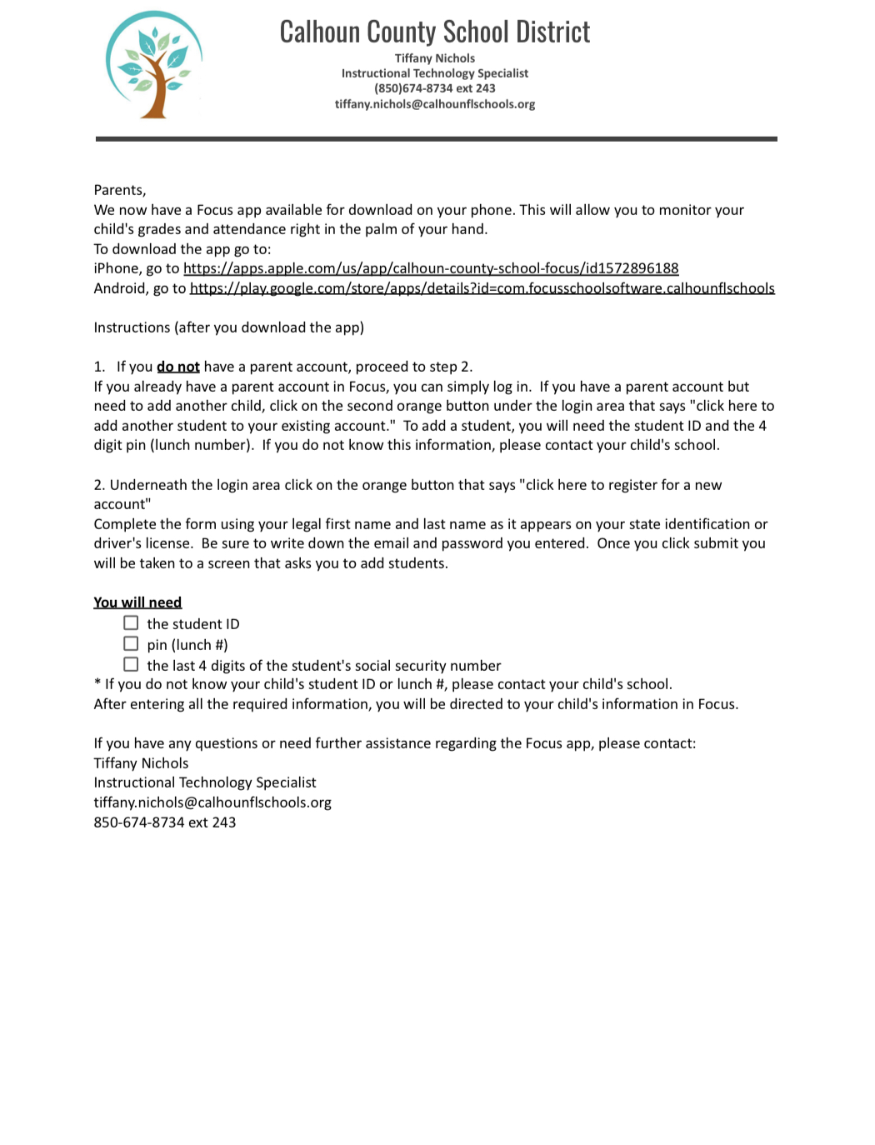
Focus App
Access student grades from your phone!

